Slide 1
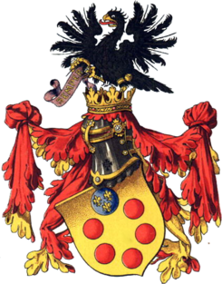


Summary
Presentations online shortly
Arcetri Astrophysical Observatory
Notes:
Cosimo d’Medici

Slide 2
OPTICON Innovation Network: Objectives
Running technology focussed workshops that will bring together scientists, engineers and technologists from the astronomy community and in particular the OPTICON R&D work packages (WP1-6) with their peers from industry, knowledge transfer professionals and other relevant science sectors
Further developing the technology roadmap that has been a fundamental tool of the previous Key Technology Network, and using this to encourage academic/industrial consortia to bid for further technology development funding
Setting up an Industry Club to bring together companies that wish to bid for contracts and develop technology in Optical and Infrared Astronomy, and to exploit our technology in other fields.

Slide 3


OPTICON Innovation Network Workshop
‘Photonic Technologies and Techniques for Exo-planet instrumentation’
Wavelength sensitive detectors
Synergies spectroscopy and imaging
Aomega and AO

Slide 4

€47 million specifically earmarked for photonics-related proposals.
Think big .. Think collectively

Slide 5
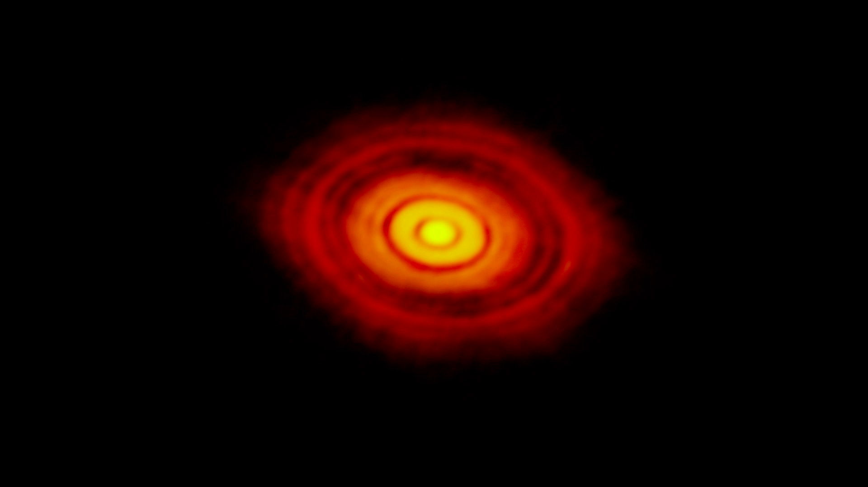
ALMA image of HL Tau
Our topic is timely

Slide 6
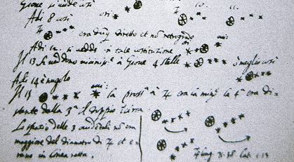
Enjoyed the weight of history
Notes:
n 10 January, Galileo noted that one of them had disappeared, an observation which he attributed to its being hidden behind Jupiter. Within a few days, he concluded that they were orbiting Jupiter:[95] he had discovered three of Jupiter's four largest satellites (moons). He discovered the fourth on 13 January. Galileo named the group of four the Medicean stars, in honour of his future patron, Cosimo II de' Medici, Grand Duke of Tuscany and Cosimo's three brothers.[96] Later astronomers, however, renamed them Galilean satellites in honour of their discoverer. These satellites are now called Io, Europa, Ganymede, and Callisto.

Slide 7
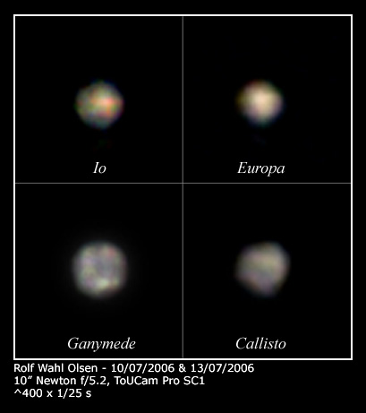
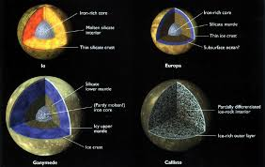
Medicean planets
Now accessible to “all”
Notes:
n 10 January, Galileo noted that one of them had disappeared, an observation which he attributed to its being hidden behind Jupiter. Within a few days, he concluded that they were orbiting Jupiter:[95] he had discovered three of Jupiter's four largest satellites (moons). He discovered the fourth on 13 January. Galileo named the group of four the Medicean stars, in honour of his future patron, Cosimo II de' Medici, Grand Duke of Tuscany and Cosimo's three brothers.[96] Later astronomers, however, renamed them Galilean satellites in honour of their discoverer. These satellites are now called Io, Europa, Ganymede, and Callisto.

Slide 8
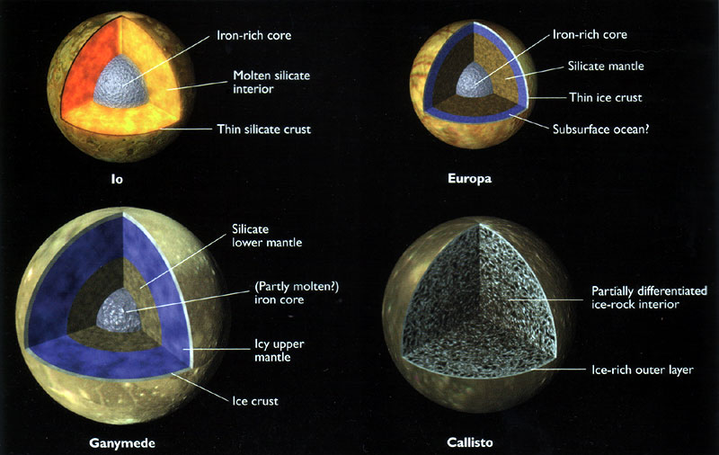
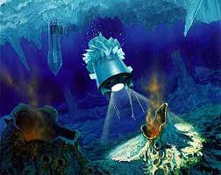
In the era of exploring them ..
Notes:
n 10 January, Galileo noted that one of them had disappeared, an observation which he attributed to its being hidden behind Jupiter. Within a few days, he concluded that they were orbiting Jupiter:[95] he had discovered three of Jupiter's four largest satellites (moons). He discovered the fourth on 13 January. Galileo named the group of four the Medicean stars, in honour of his future patron, Cosimo II de' Medici, Grand Duke of Tuscany and Cosimo's three brothers.[96] Later astronomers, however, renamed them Galilean satellites in honour of their discoverer. These satellites are now called Io, Europa, Ganymede, and Callisto.

Slide 9
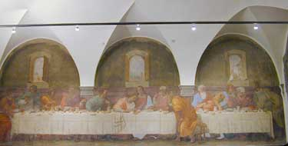
Locally, we have enjoyed the weight of history ..
Franciabigio (1514)

Slide 10
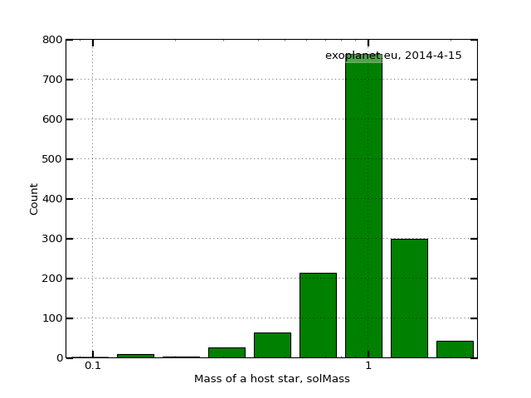
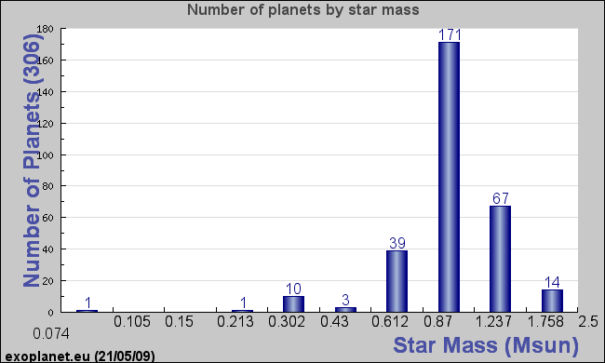

The science problem
K, G, F, A dwarfs
M dwarfs
Notes:
update

Slide 11
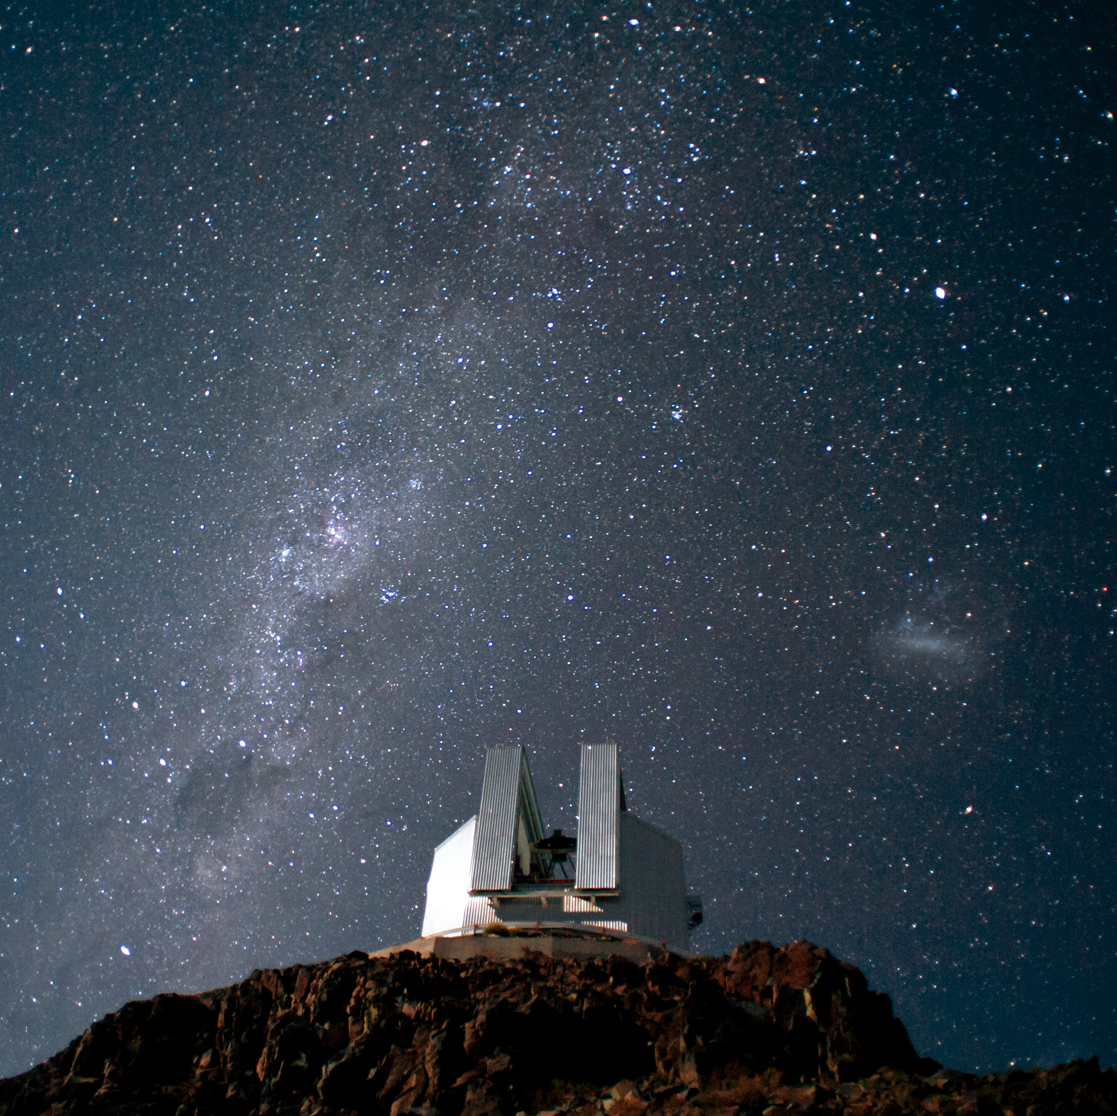

The solution
Photonic Spectrograph for NTT
Stage 1 proposal to ESO sucessful .. next stage due Feb 2015
Beware emails from me ..

Slide 12
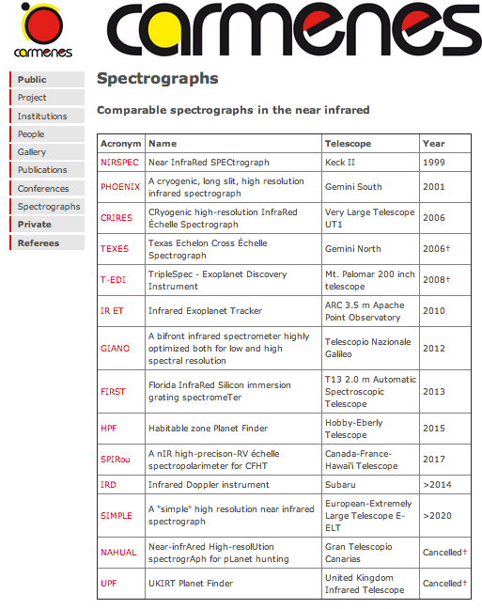
Lots of competition .. but no Southern projects
Notes:
Include URL

Slide 13
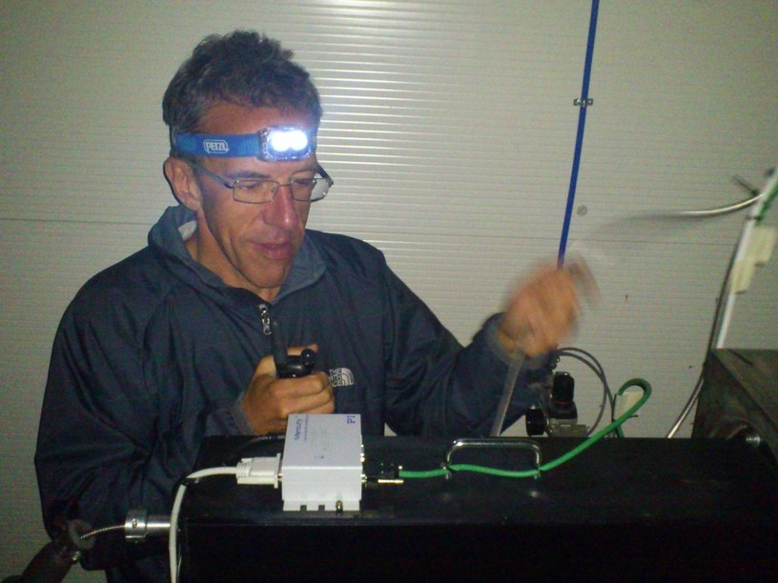
Thanks
You – lots of great ideas
Patrizia - administration
John - logo
Luca – disucssion
Ernesto ..

