Slide 1
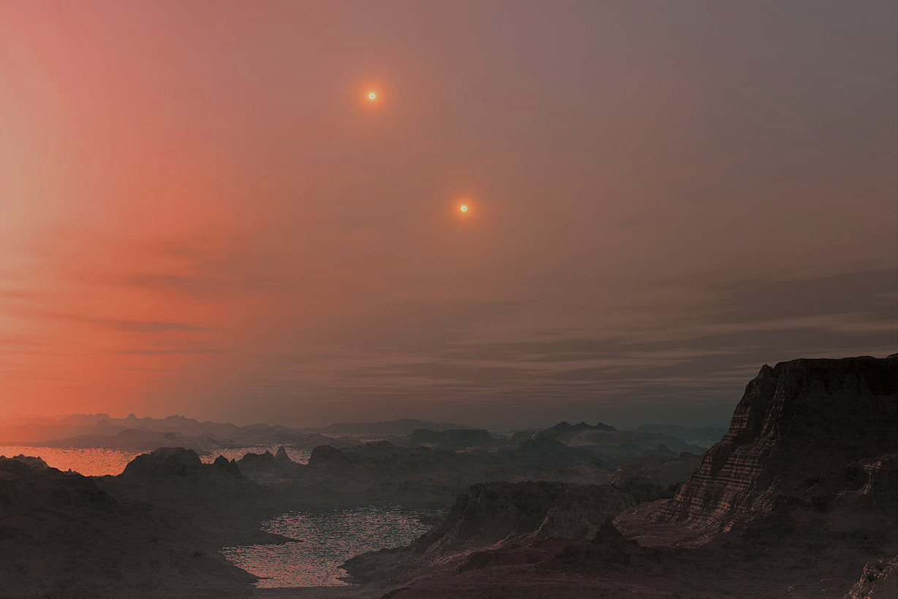
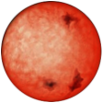



Exoplanets at the bottom of the main sequence
John Barnes
Open University, UK
Collaborators: H. Jones, D. Pinfield, M. Tuomi (U. Hertfordshire, UK); G. Anglada-Escudé (U. Hertfordshire/QMUL, UK); James Jenkins, Patricio Rojo (U. de Chile); Andrés Jordán, Dante Minniti, Pamela Arriagada, (U. Católica de Chile); S. Jeffers (Göttingen)

Slide 2
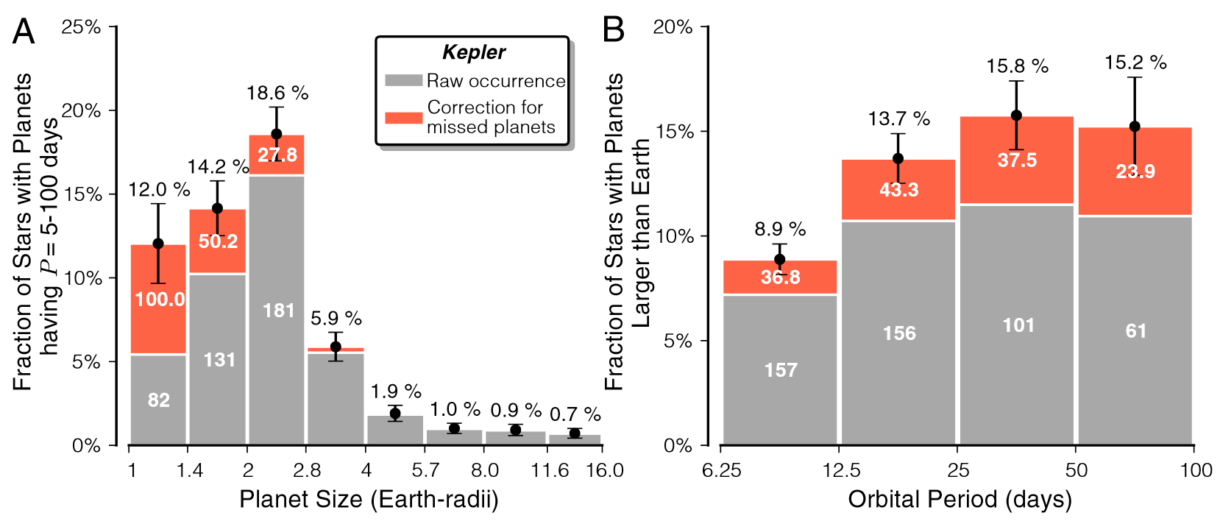
G & K dwarf rocky planet frequencies
603 Kepler G & K candidates (Petigura et al., 2013, Proc. Nat. Acad. Sci, 19273 - arXiv 1311:6806 )
26 ± 3 % of Sun-like stars harbour an Earth-size planet (1-2 R_{earth} P = 5 - 100 d
1.6 ± 0.4 % occurrence of Jupiter sized planets (8 - 16 R_{Earth})
22 ± 8 % occurrence for 1 - 2 R_{Earth} planets receiving 0.25 - 4 F_{Earth}

Slide 3
M dwarf planet frequencies
HARPS early-mid M dwarf sample (Bonfils et al., 2013, 549, 109)
Frequency
Period [d] 100-1000 M⊕ 1-10 M⊕
1 - 10 ≤ 0.01 0.36 ±
10 – 100 0.02 ± 0.52 ±
> 25% of early M dwarfs harbour (1-10 M⊕) planets in 1-10 d orbits
....but may be as high as 100% !!
Freq. of M dwarf HZ planets, η⊕ = 0.41 ± (i.e. 28% - 95%) !!!
^{0.25}
^{0.10}
^{0.03}
^{0.01}
^{0.50}
^{0.16}
0.54
0.13

Slide 4
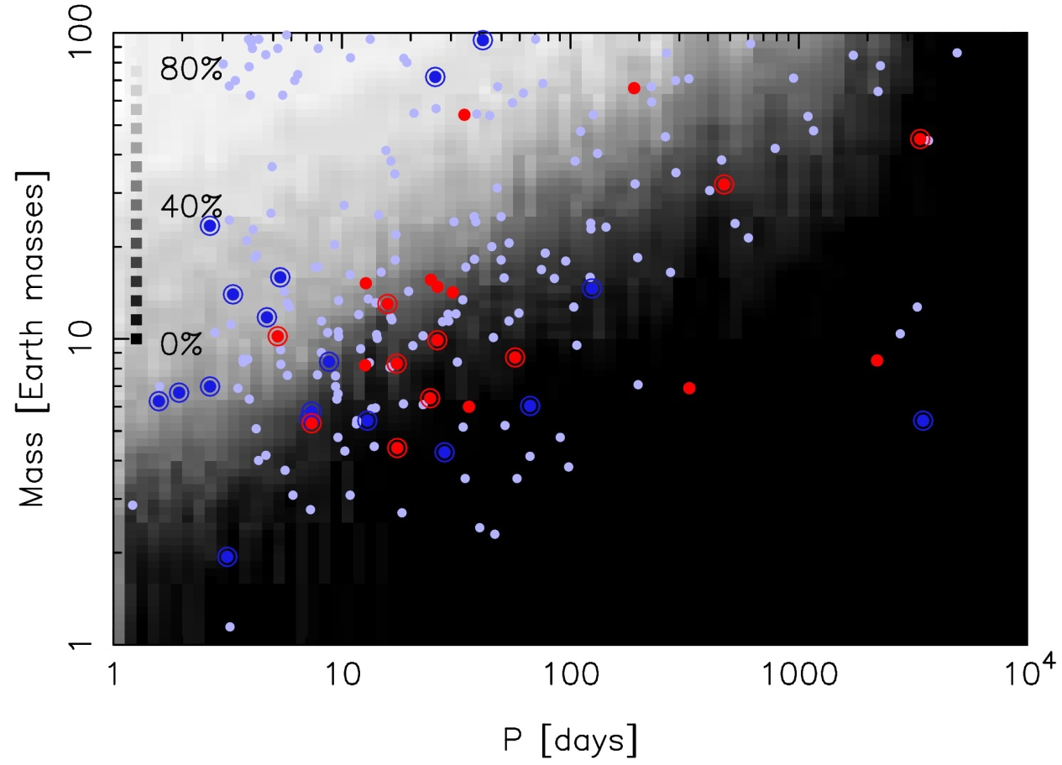
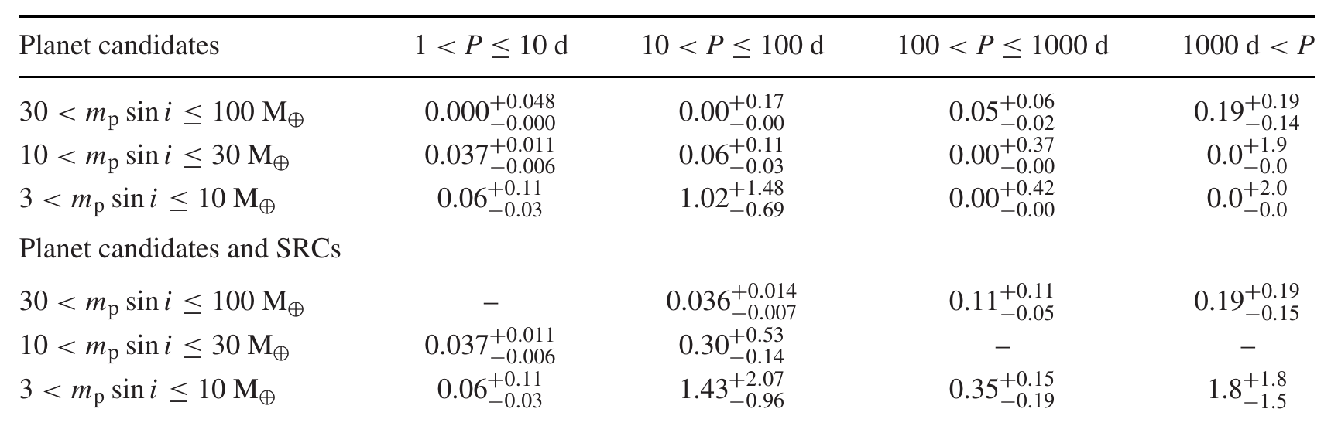
Early M dwarf planet frequencies
HARPS/UVES M dwarf samples
Bayesian search for low mass planets → new low amplitude planets / candidates
Tuomi et al. (2014)
P = 10-100 d, 3 M⊕ < m_{p}sini < 10 M⊕ occurrence rate = 1.02 ±
^{0.48}
^{0.69}
Habitable Zone 3 M⊕ < m_{p}sini < 10 M⊕ occurrence rate = 0.21 ±
^{0.03}
^{0.05}

Slide 5
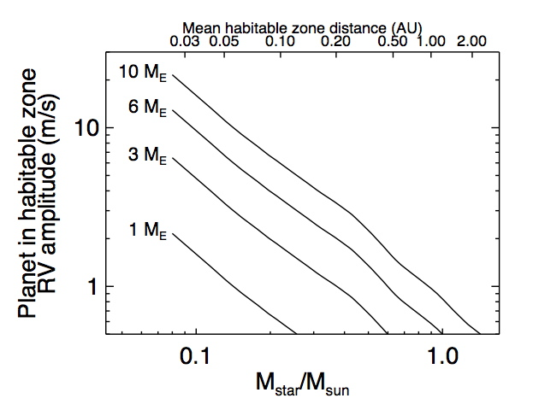
Sensitivity: RVs of habitable zone planets
S/N break-even point between optical
and NIR surveys is early- to mid-M SpT
Infrared
RV
Optical RV
Mean intrinsic RV
jitter ~ 1 m/s
measured in optical by
Infrared brings reduction in spot contrast and therefore jitter by a factor of two
Asteroseismology noise
M9V
M6V
M3V
M1V
G2V
c.f. Earth ~9 cm/s amplitude!

Slide 6
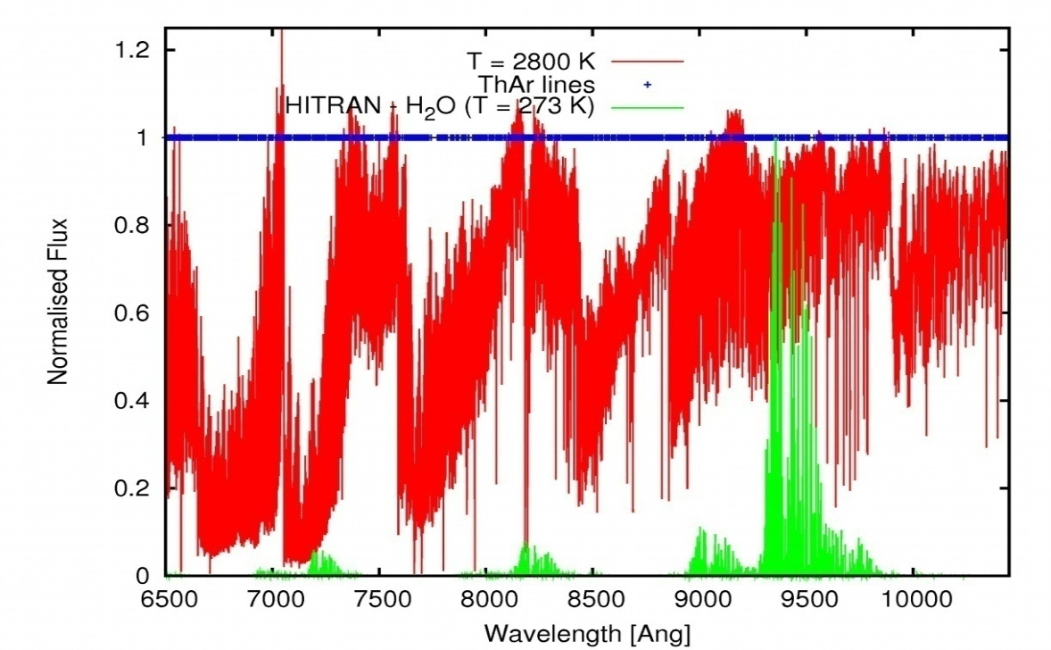
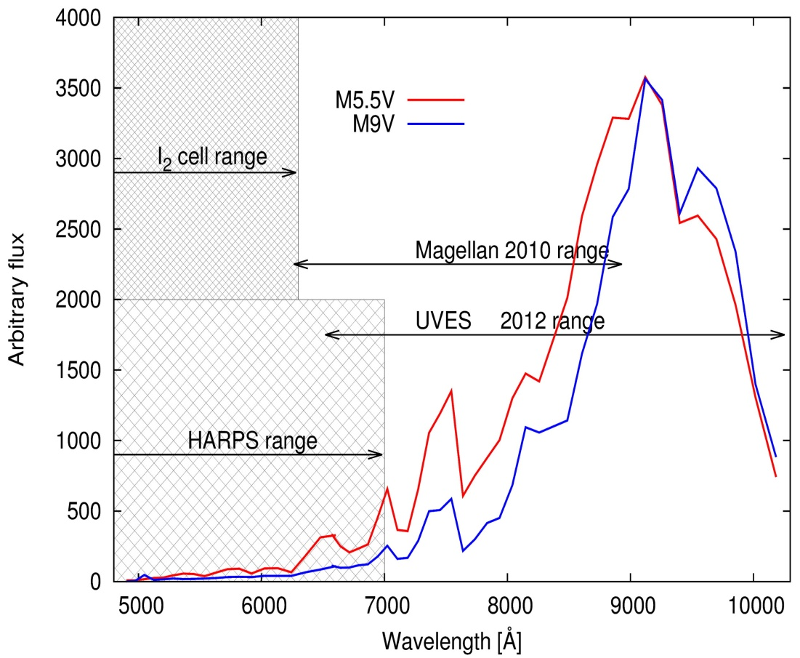
RV sensitivity in the red-optical
RO spectral information 0.65 – 1.05 μm region (M6 spectrum – red)
Atmospheric O₂ and H₂O lines (green)
SED (incl. MIKE & CCD response) for typical M5.5V & M9V dwarfs.
Red optical and HARPS region fluxes:
F_{0.7-0.9} /F_{0.5-0.7} = 11.5 (M5.5V) and 19 (M9V)
(based on MIKE instr & CCD)

Slide 7
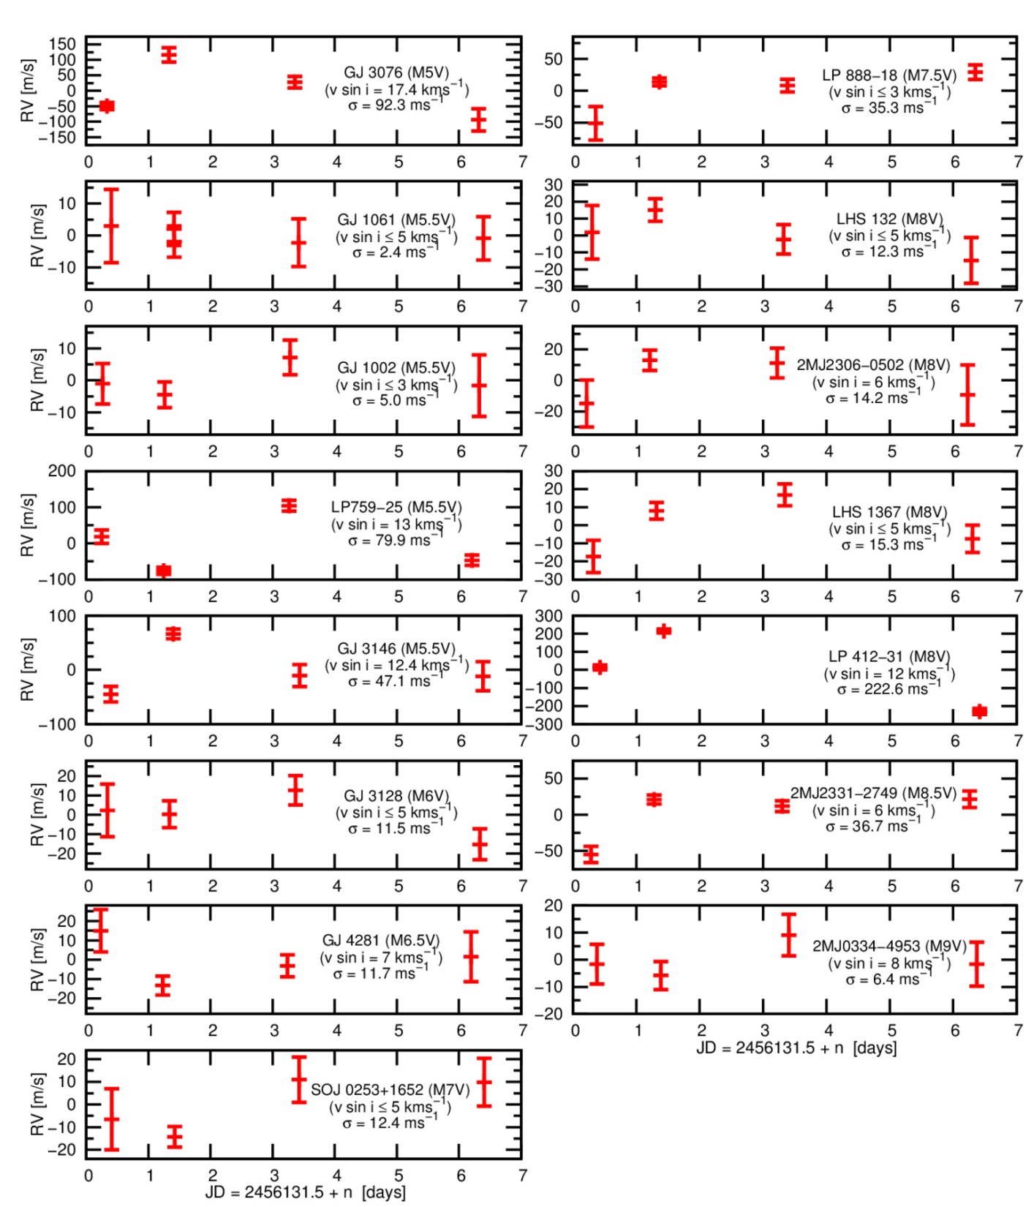
Red Optical Planet Survey (ROPS) - RVs at M5V - M9V

Slide 8
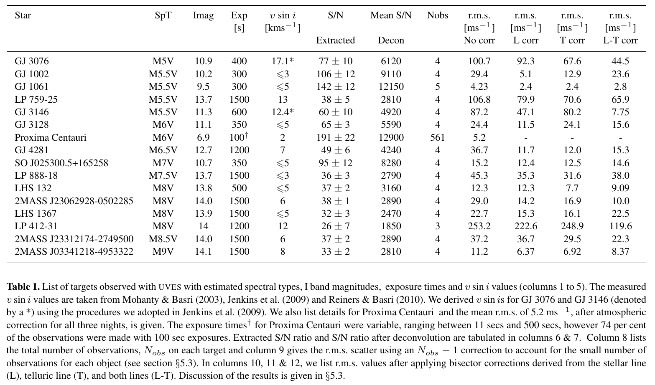
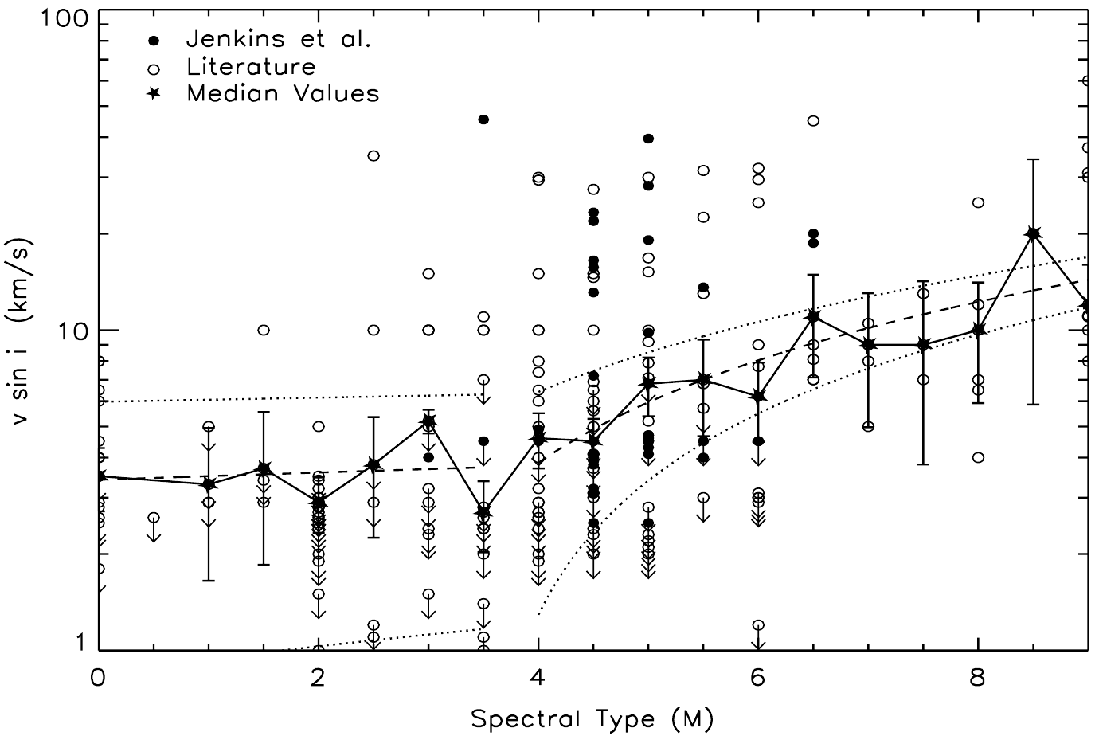
Vital statistics and RVs of ROPS targets

Slide 9
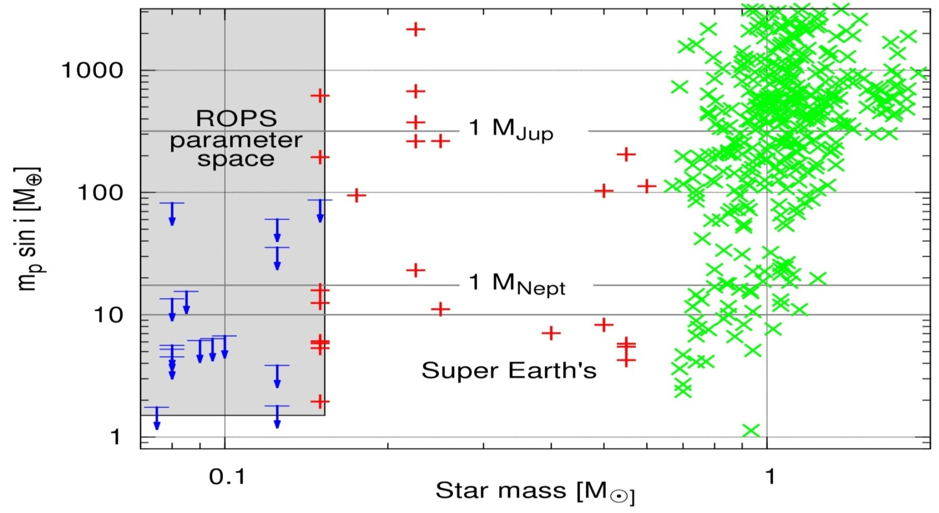
ROPS parameter space
Barnes et al. 2014, MNRAS, 439, 3094 “Preceision Radial Velocities of 15 M5-M9 dwarfs”
Barnes et al. 2012, MNRAS, 424, 591 “Red Optical Planet Survey: a new search for habitable earths in the southern sky”
No planets with m_{p} sin i > 10 M⊕ in 0.03 AU orbits
Observations rule out planets with m_{p} sin i > 0.5 M_{J} at 0.03 AU for all our targets

Slide 10
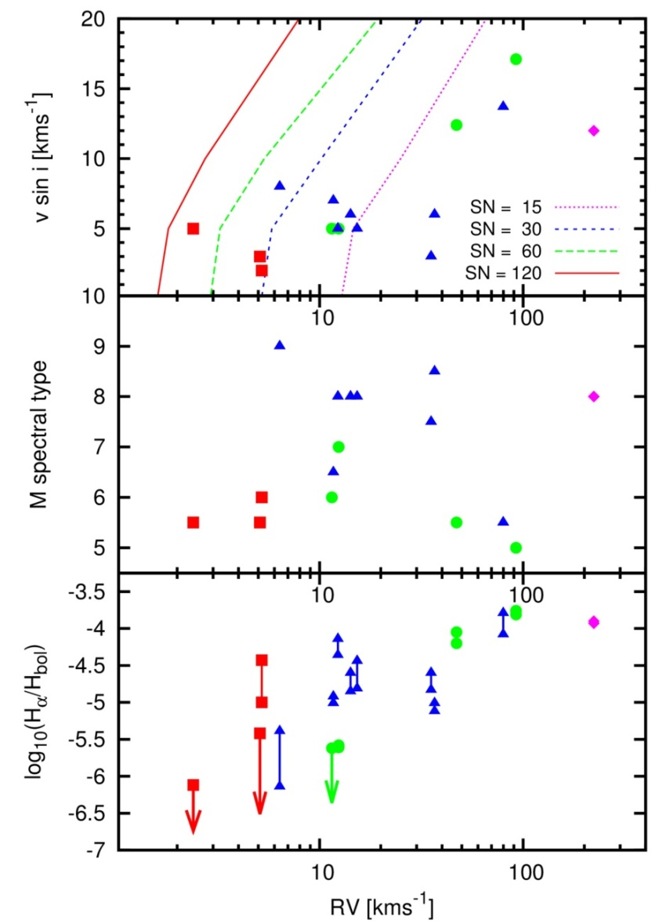
Activity vs observed RVs
v sin i: most rapid rotators show greatest deviation from Poisson limited precision
No clear trend with spectral type
Hα emission shows clear trend with RV precision
→ Suggests that activity is important, even in late M dwarfs
Log(H_{α}/L_{bol}) important when choosing a sample
Observing only slow rotators may lead to a biased against detecting planets

Slide 11
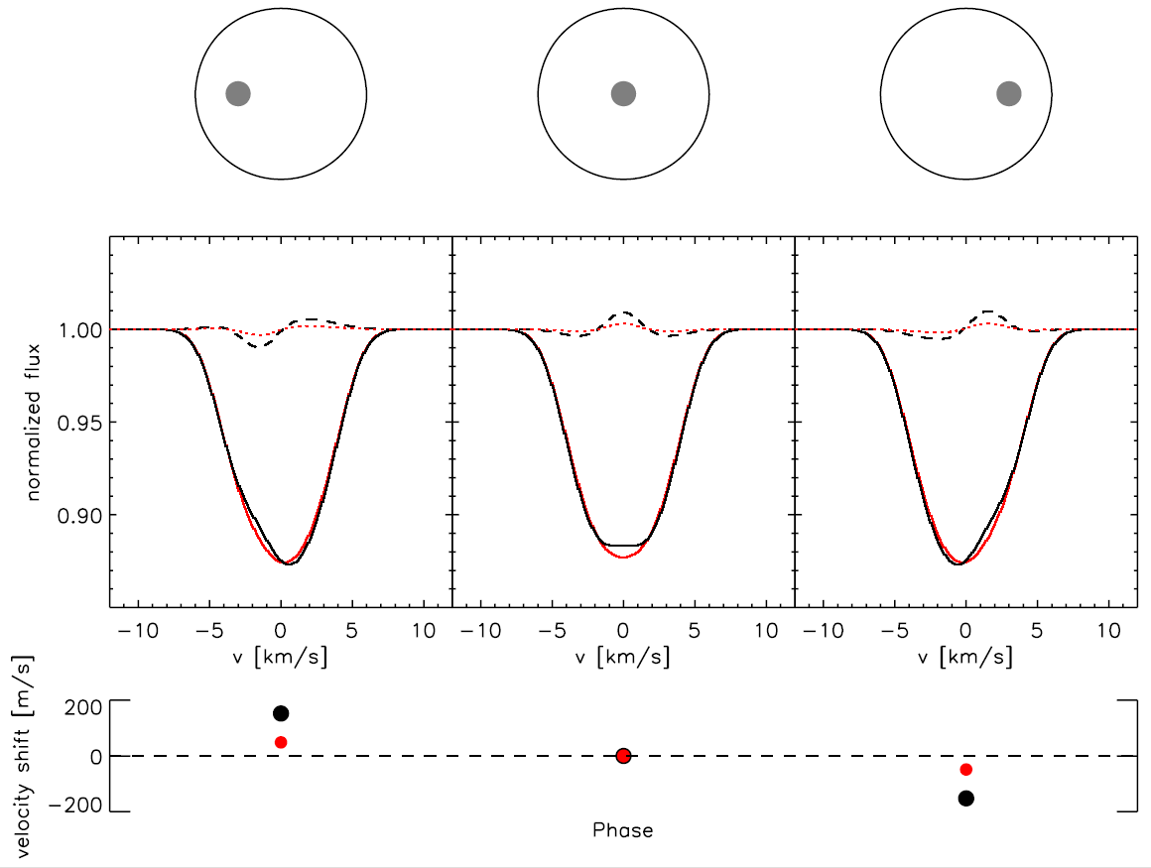
Effect of a spot on the line profile
Reiners et al. 2009

Slide 12
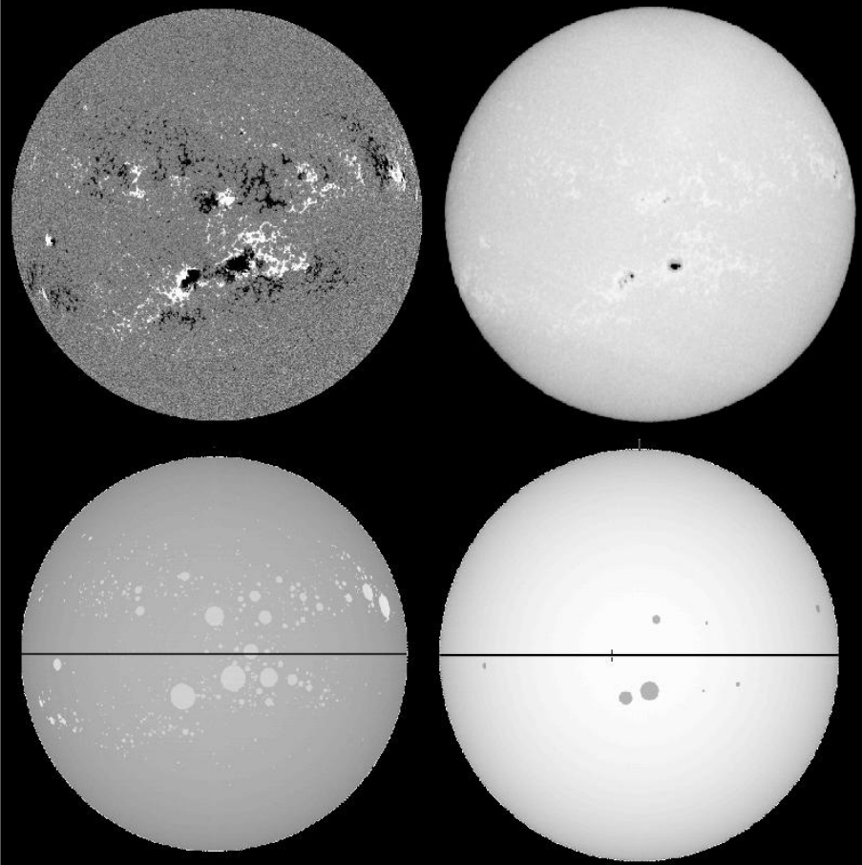
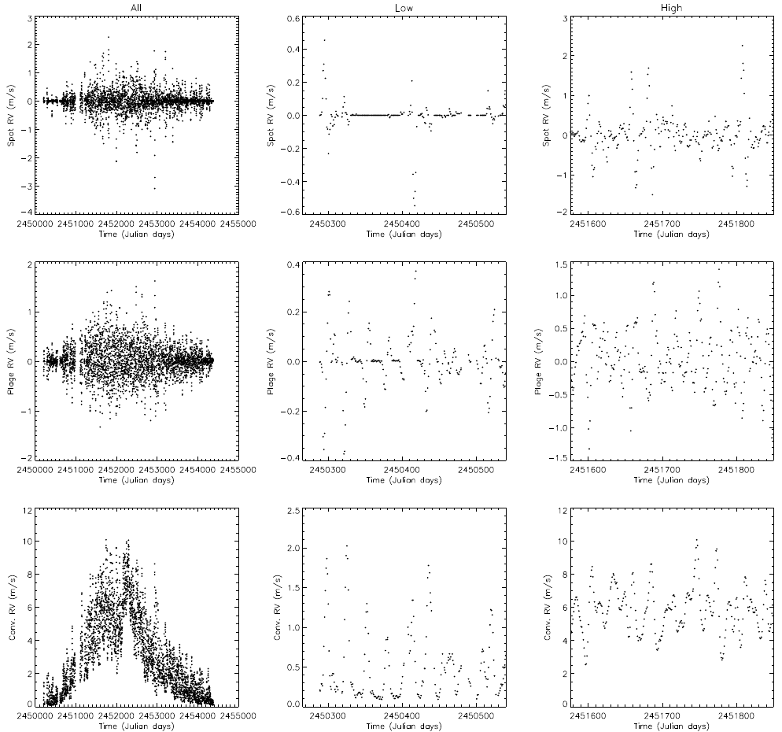
Dealing with activity - The Sun
Earth induces an RV signal with ~9 cm/s RV variability
What about activity levels from the Sun?
Meunier, 2010, A&A, 512, 39

Slide 13
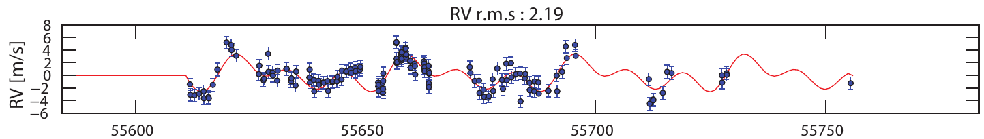
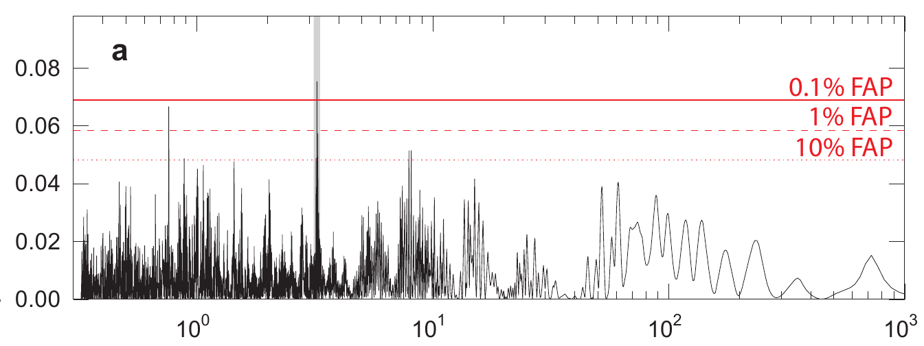
α Centauri B b – a planet?
Planet claimed orbiting our nearest stellar system (Dumusque et al. 2012, Nature)
P ~ 3.2 days, K ~ 0.5 m/s (50 cm/s), FAP = 0.02-0.05%
Similar analysis by Hatzes (pre-whitening data by filtering out Fourier components detects signal, but with 7% FAP)
(from Poster by X. Dumusque, Protostars&Planets, Heidleberg, 2013, Poster #2K033

Slide 14
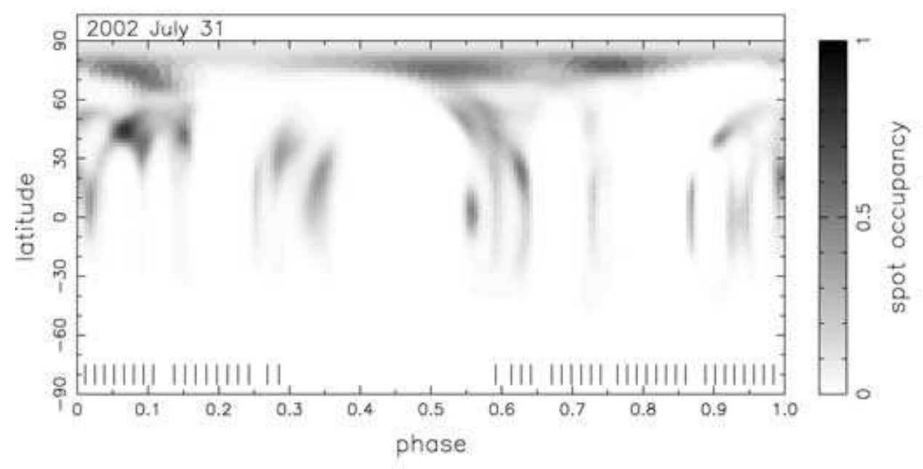
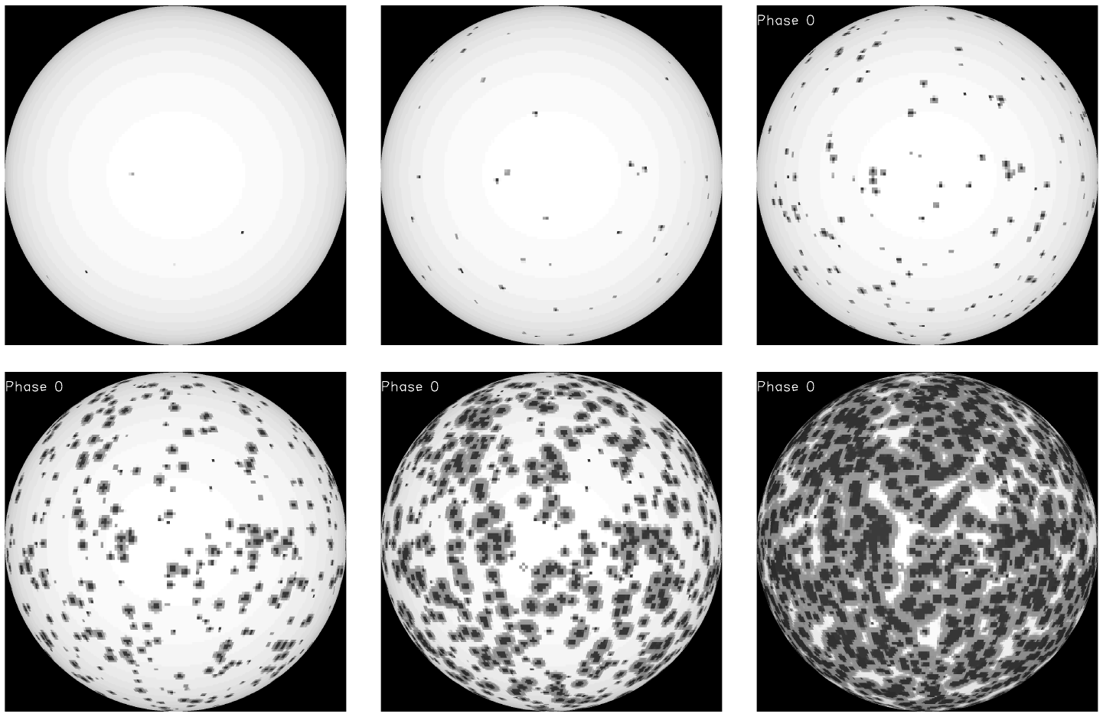
Starspots on M dwarfs
Doppler Images of (near fully convective) M dwarfs show uniform spot coverage – 10 % coverage (Barnes et al 2001, 2004)‏
TiO band analysis spot coverage: 20 to 40% (O'Neal et al 2004)‏
Solar activity levels are extrapolated to active stars (Solanki 1999)‏
Solar min (0.03%) Solar max (0.3%) 1.9%
Barnes et al. (2001 & 2004, MNRAS)
9.0% 29.5% 62.4%

Slide 15
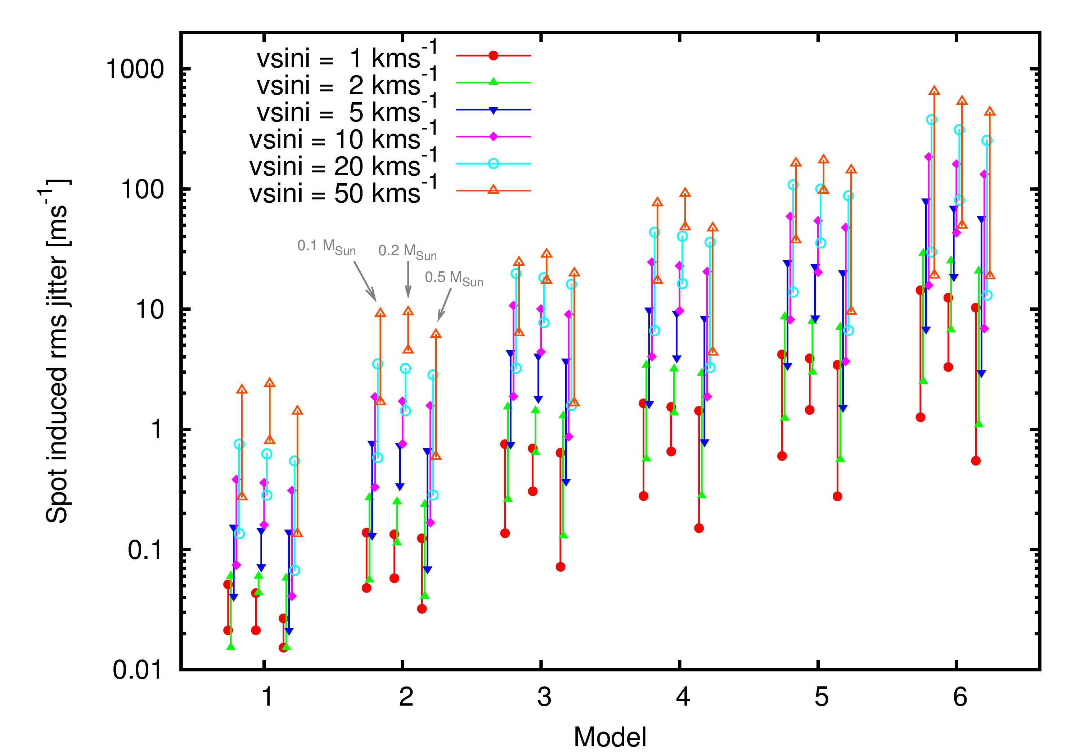
Radial Velocity – Random Spots
T_{spot} = T_{phot} - 200K
T_{spot} = 0.65 T_{phot}
Solar min + max models lowest RV jitter ~ 1m/s
In agreement with Lagrange et al (2010)‏
Models 1 - 6
Solar min
Placing spots randomly decreases jitter (c.f. localised spot groups at earlier, FGK spectral types)
Solar max
M6 V : M4 V : M0 V
0.1 M☉ : 0.2 M☉ : 0.5 M☉
0.3 - 6 ms⁻¹ variation found from long term (6yr) activity variations in early-M dwarf sample (Gomes da Silva et al., 2012)

Slide 16
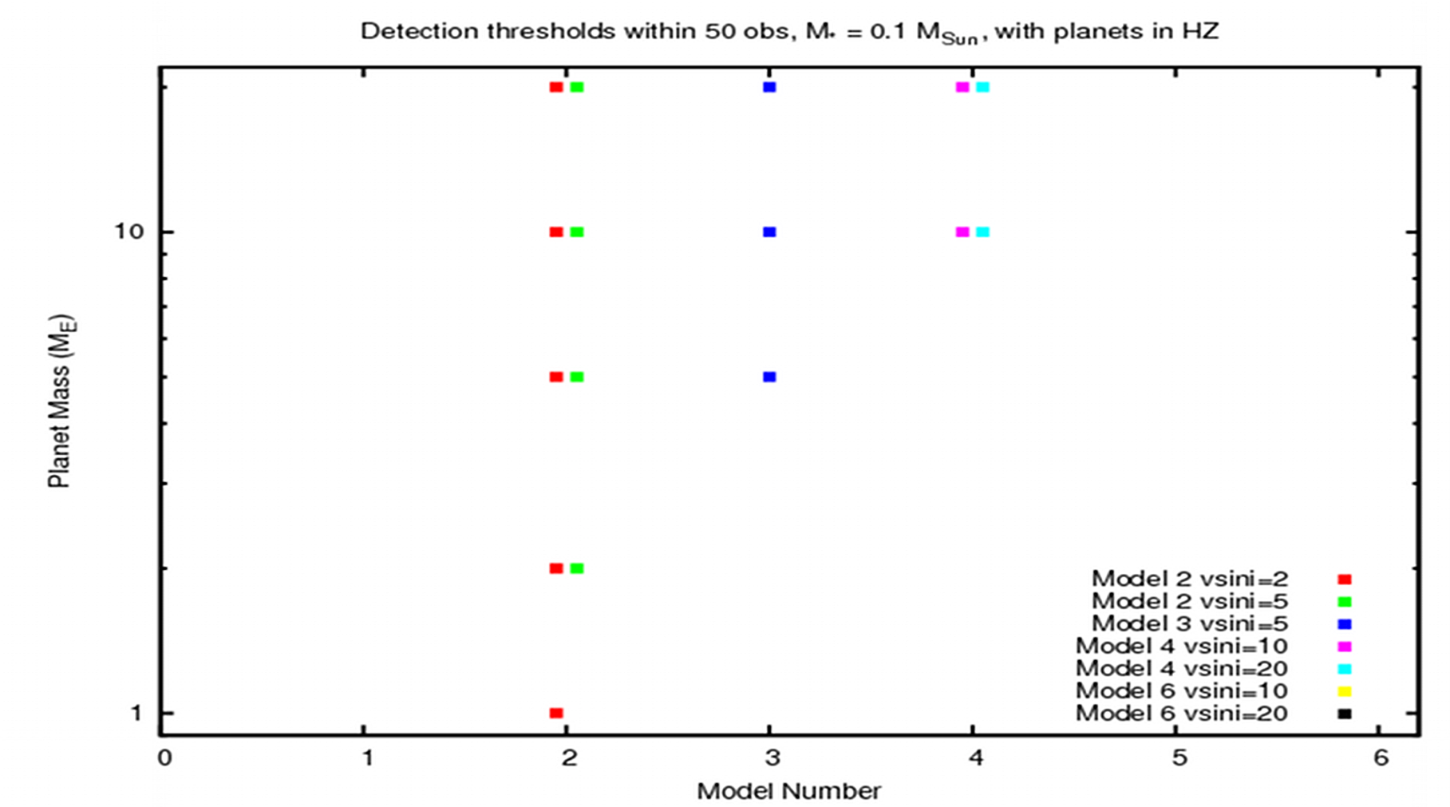
Detection thresholds
Detection thresholds summarised for planets orbiting a 0.1 M☉ star with 50 observation epochs
Doubling of the v sin i effectively doubles the jitter
Barnes, Jeffers & Jones, 2011, MNRAS, 412, 1599: “The effect of M dwarf starspot activity on low-mass planet detection thresholds”

Slide 17
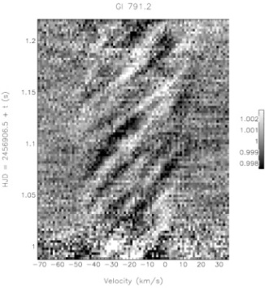
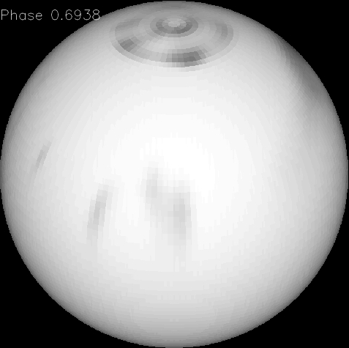
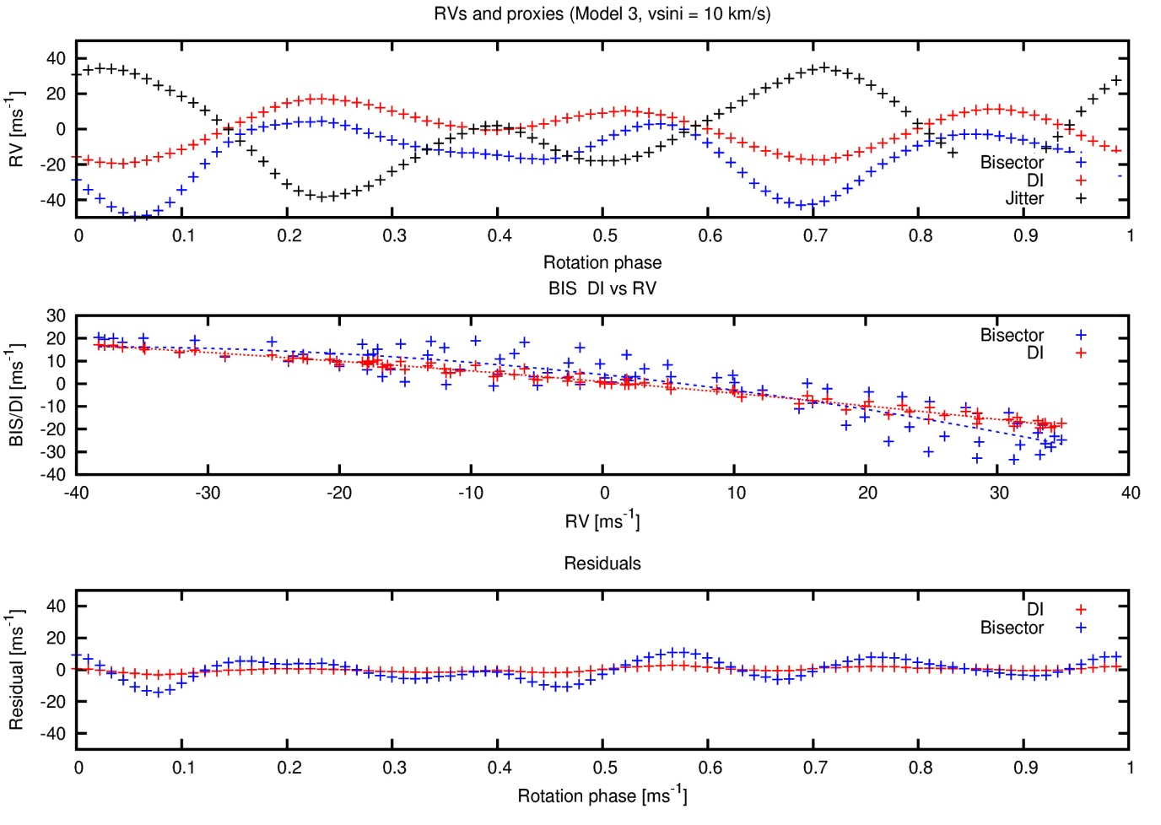
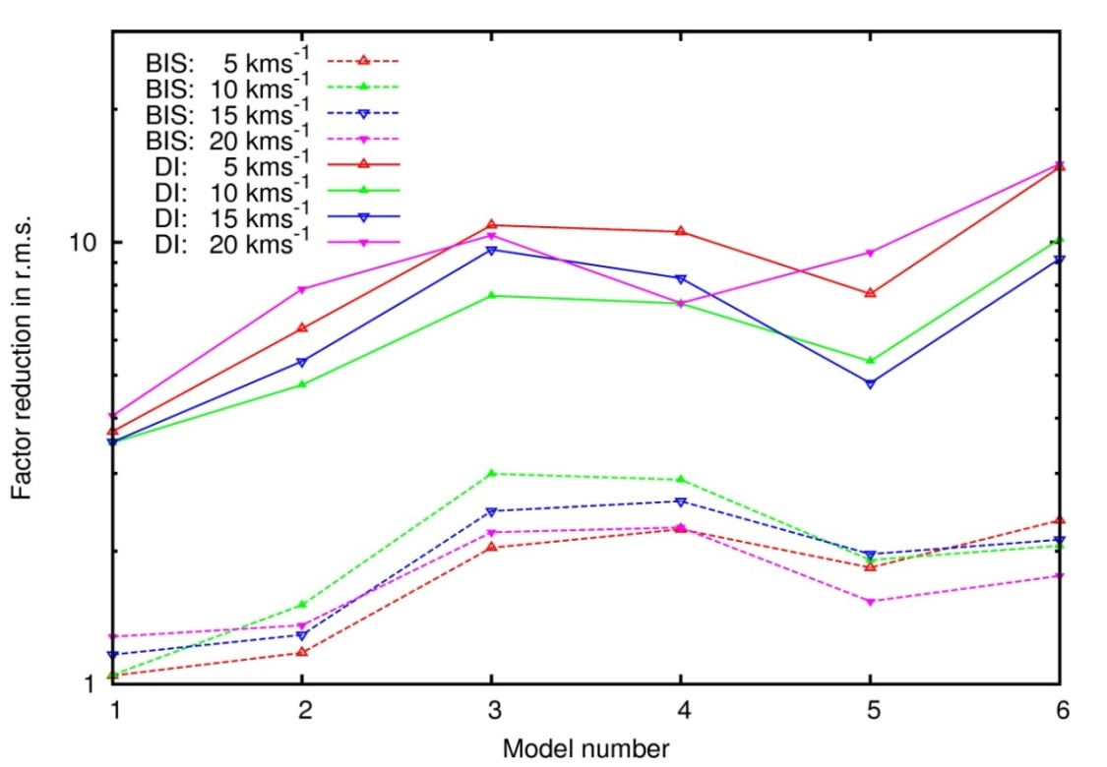
Removing RV signatures from spots
Starspot simulations of M dwarfs suggest that planets of <10 M⊕ may be detected in a few 10s of epochs in the near-infrared
Line profile pre-whitening demonstrated to be effective (Moulds et al., 2013)
Gaussians fitted to residual timeseries
Starspot trails in line profiles but reconstruction of stellar surface (Doppler imaging) may be more successful at lower rotation rates

Slide 18

Summary
Planets expected in short numbers at the bottom of the main-sequence
Early M dwarf 0.33 - 1.5 planets per star (3-10 M⊕ in 10 - 100 d orbits)
~0.2 Habitable Zone planets per star
Existing instrumentation with non simultaneous calibration spectrum and tellurics as reference → 2.4 – 6.5 ms⁻¹ precision at best
Exciting and promising results for upcoming instrumentation
ROPS: no planets with m_{p} sin i > 10 M⊕ in 0.03 AU orbits
(9/14 M5-M9V stars 4 nights spanning 1 week r.m.s. , r.m.s. < 16 ms⁻¹)

Slide 19

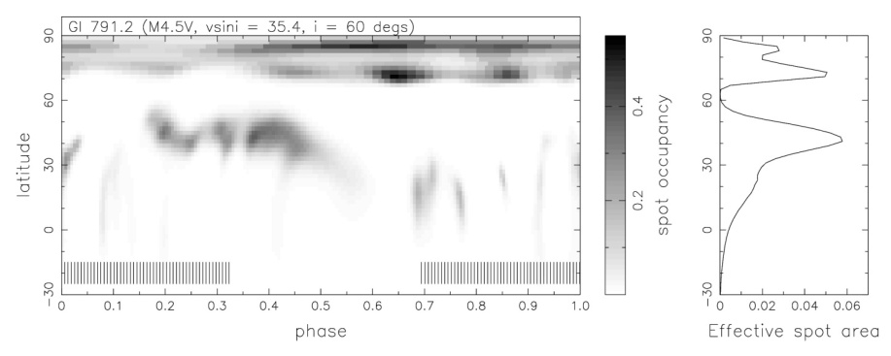
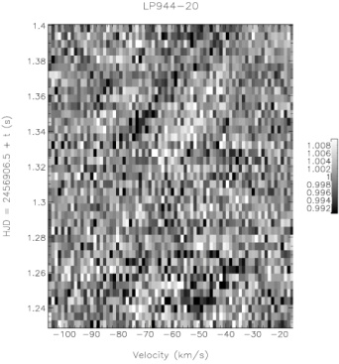
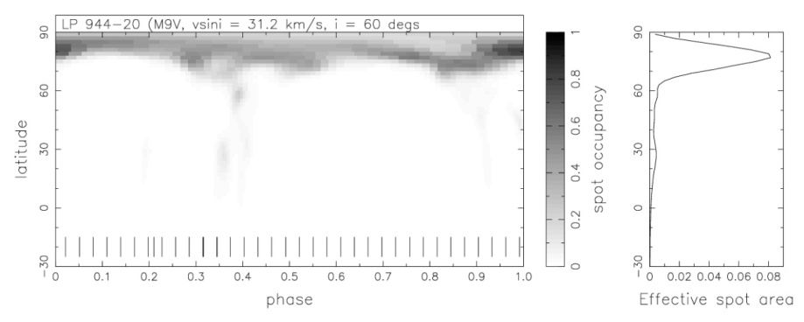
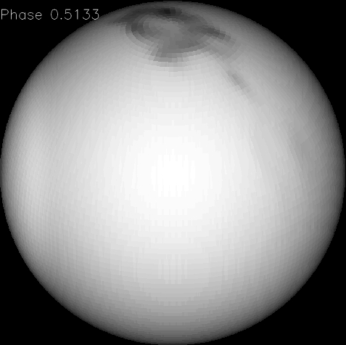
Summary
Late M dwarfs on average show significant rotation and care is required to ensure an unbiased sample
i.e. selecting only slow rotators may bias towards face on orbits that show no/small RV variation
Campaigns targeting stars at the bottom of the man sequence will increase chances of detecting low mass planets though optimisation of observing epochs
Planets are expected in few-day to few x 10 day orbits
Jitter from starspots can be corrected most easily using e.g. Doppler imaging methods
First Doppler images of fully convective stars
F

Slide 20
Fine!

Slide 21
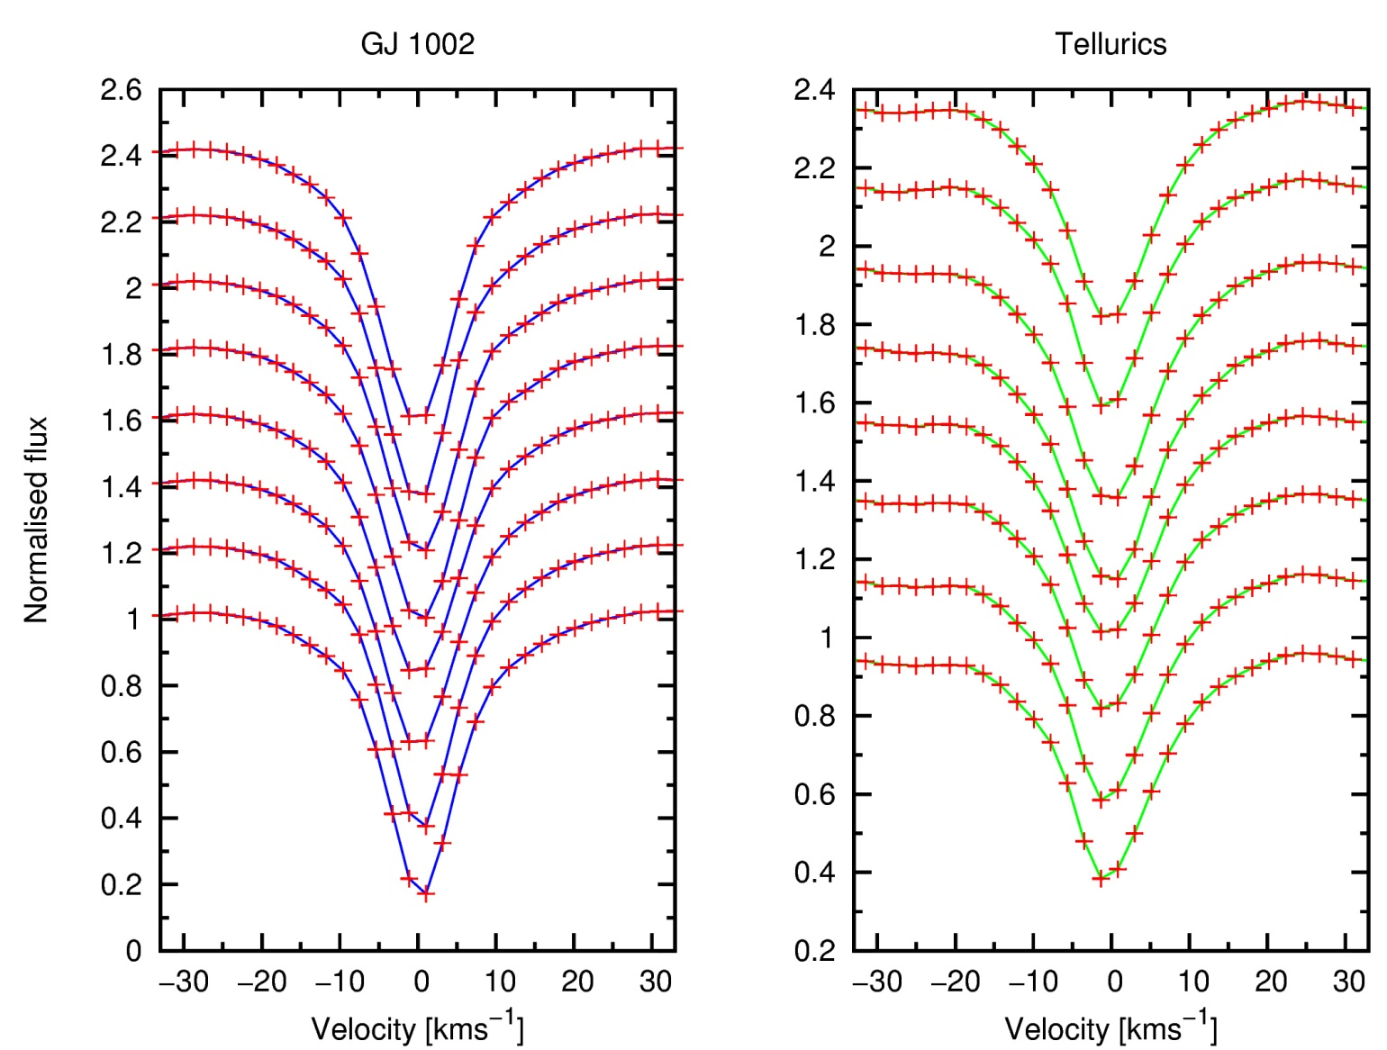
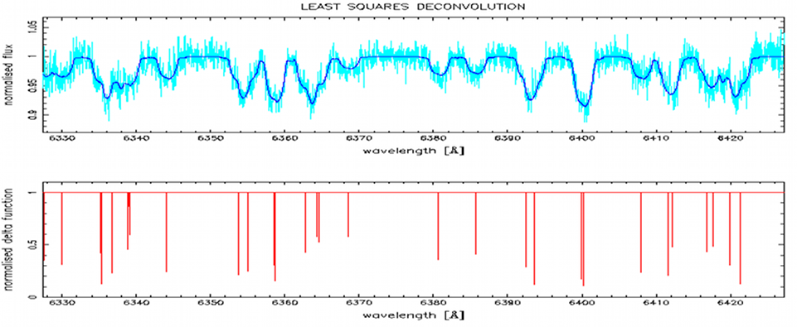
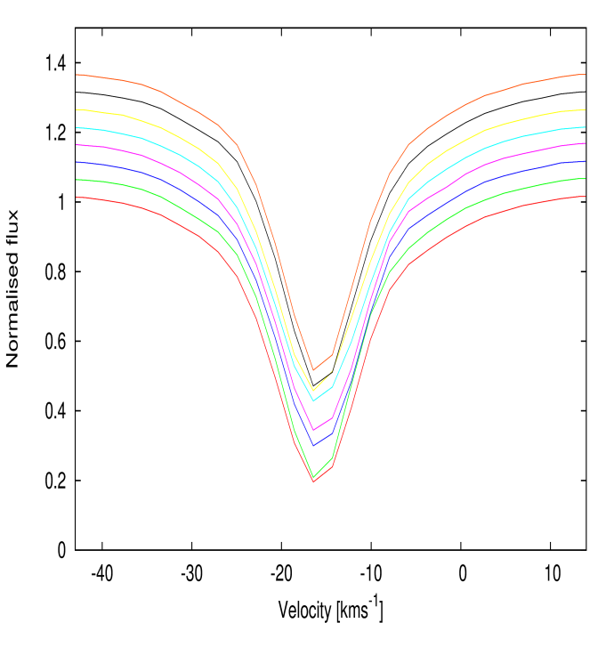
Deconvolution
S/N in a single spectrum is typically of order a few to to a few hundred
Several hundred to several thousand lines in a typical spectrum
Use model spectrum to deconvolve mean profile from observed spectra
A weighted least squares profile is derived, with high S/N ratio governed by the number of lines (typically factor of a few x10 gain in S/N)
GJ 1002 (M5.5V)
S/N ratios of order ~1000+ can be achieved for a single spectrum, enabling radial velocities with high precision to be determined

Slide 22
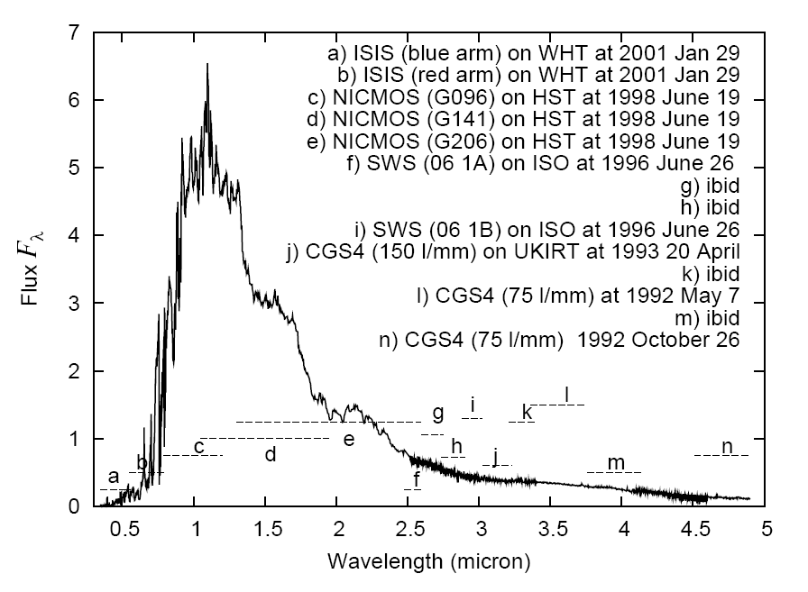
Optimising M dwarf planet searches
M6 Spectrum
Red-optical : V – I 2.5 - 5
Near infrared : V - J 5 - 8
M4V – M9V
Visible
Red optical
Near infrared Y-band
Adapted from Pavlenko et al. 2006
Pavlenko et al. 2006

Slide 23
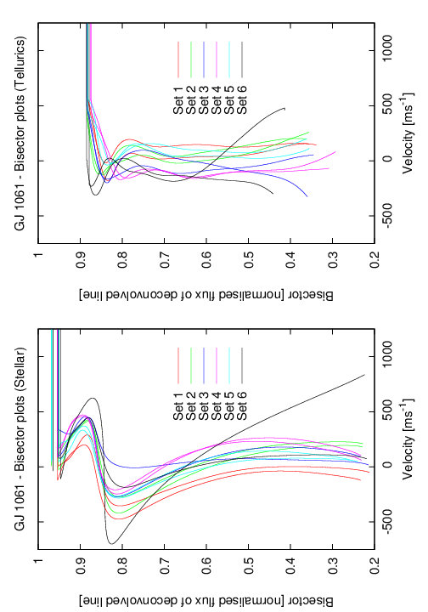
Line bisectors
Line bisector correction (slit illumination / stellar activity effects)
200 m/s → 3 microns on detector (15 micron pixels)

Slide 24


Spectral timeseries of mid-late M dwarfs
Gl 791.2
LP944-20
M 4.5 V
v sin i = 35 kms⁻¹
M 9 V
v sin i = 31 kms⁻¹

Slide 25

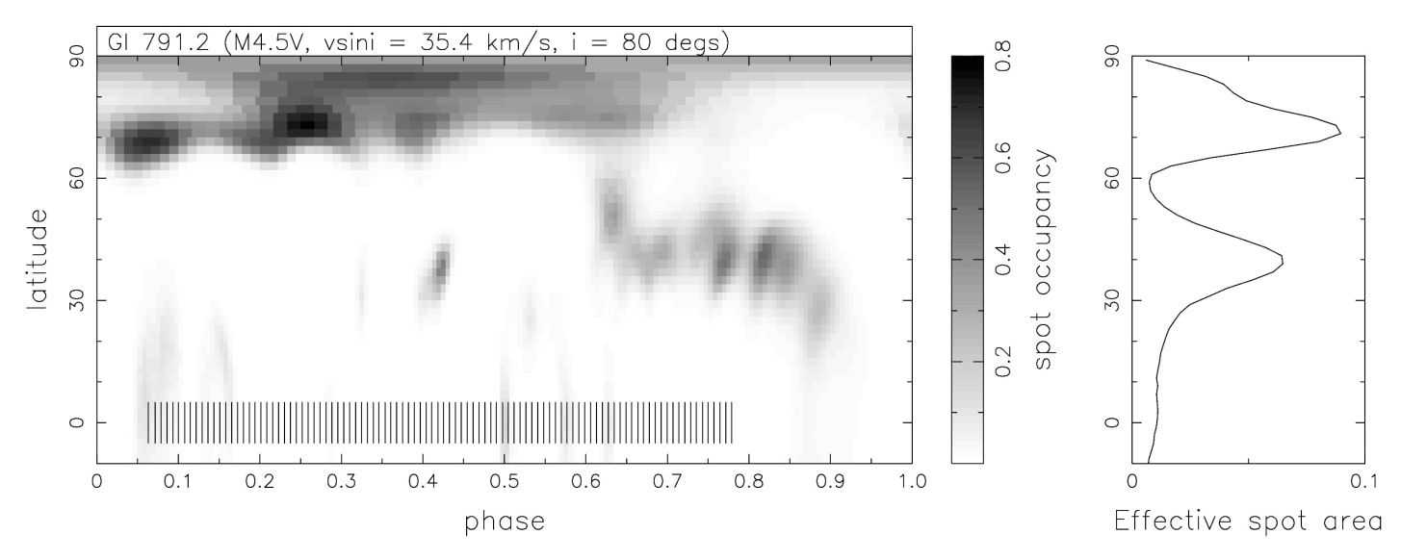
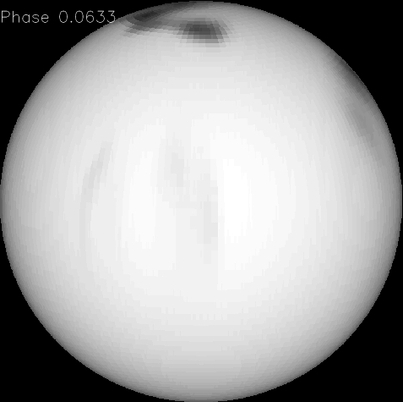
Gl 791.2 – A rapidly rotating M 4.5 dwarf

Slide 26
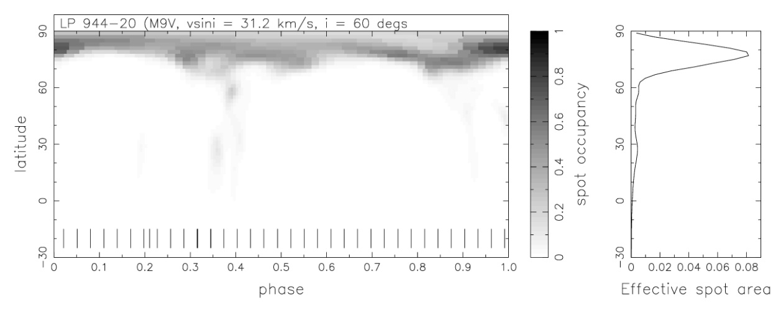
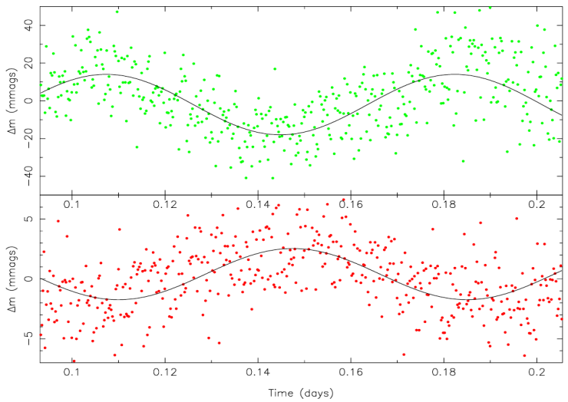
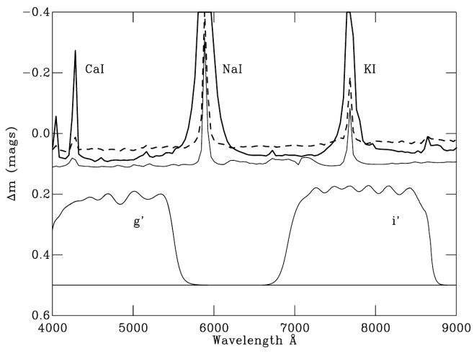
LP944-20 – A rapidly rotating M 9 dwarf
Is variability due to starspots?
e.g. Littlefair et al. (2008) – TVLM 513-46546 (M8.5V) shows anti-correlated g’ and r’ band photometry → dust clouds

Slide 27
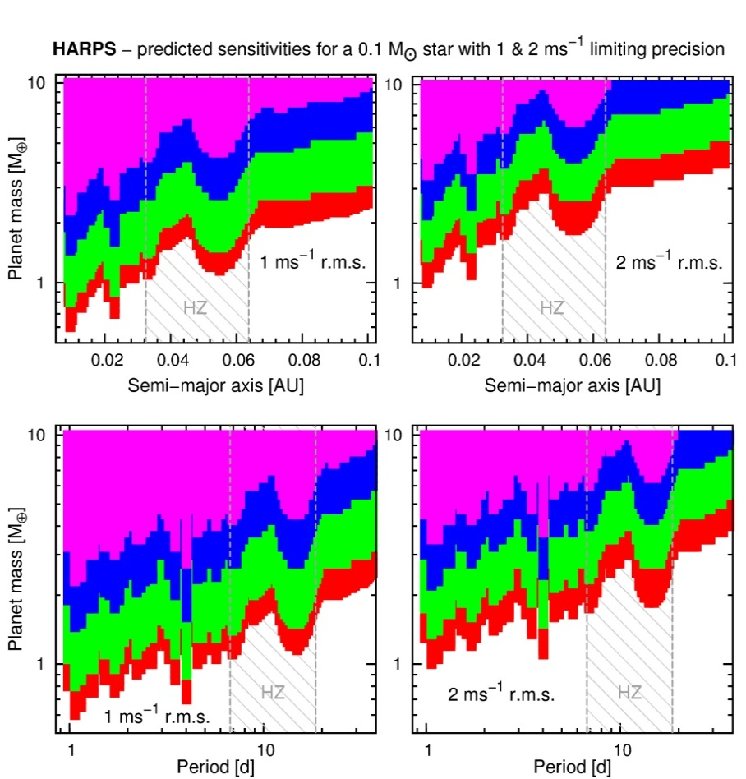
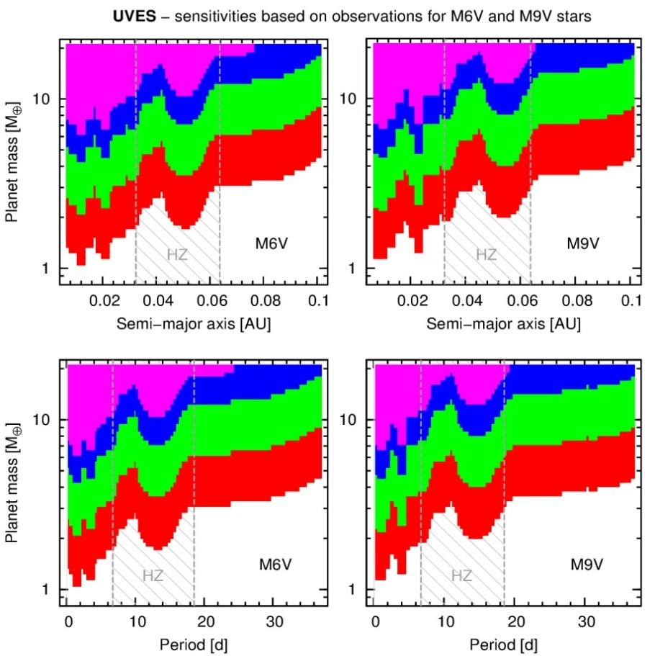
Continuing ROPS with HARPS and UVES
HARPS / HARPS-TERRA (Anglada-Escude, 2012) can target the brightest M5V – M6.5V star
UVES / VLT – fainter M5V – M9V targets
- 30 observation epoch planet recovery simulation
- vsini = 1 (red), 2(green), 5(blue), 10(magenta) kms⁻¹
- Habitable zone range, runaway – max-greenhouse (Kopprapu,2013)

